Slide 1

Notes:
2024 poster: Paul Rousteau brings Roland-Garros to the Seine
Tennis is back in Paris with the French Open at Roland Garros.

Slide 2

AI Predicts Tennis
🎾
Notes:
My name is Yann, and in this video, I’ll show you how I’m using machine learning to predict the winner of the tournament

Slide 3
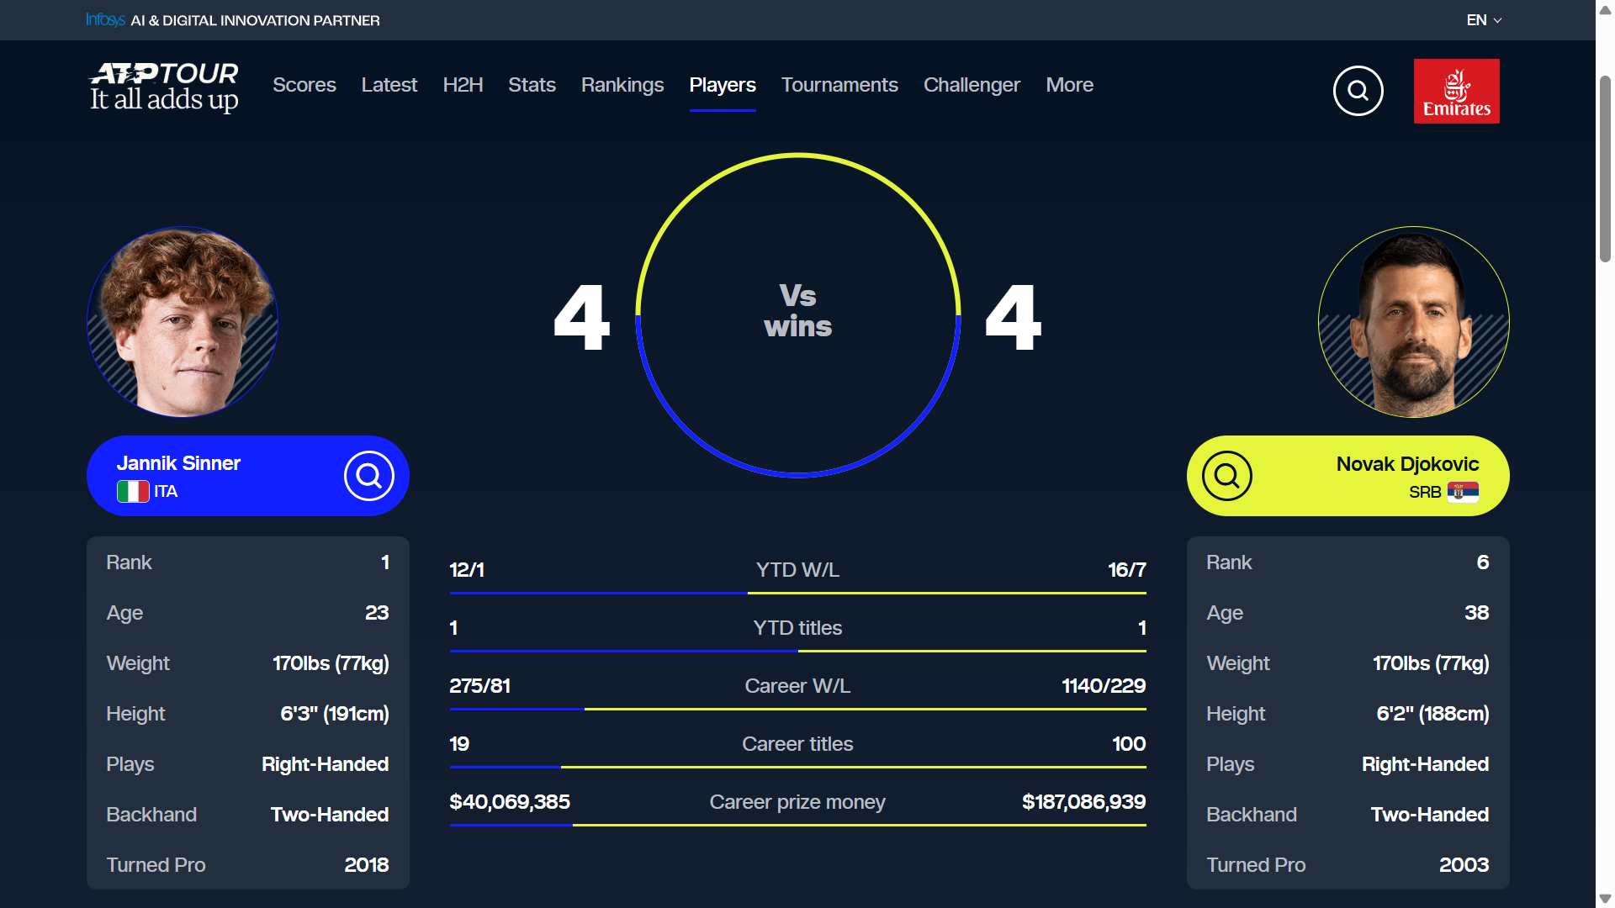
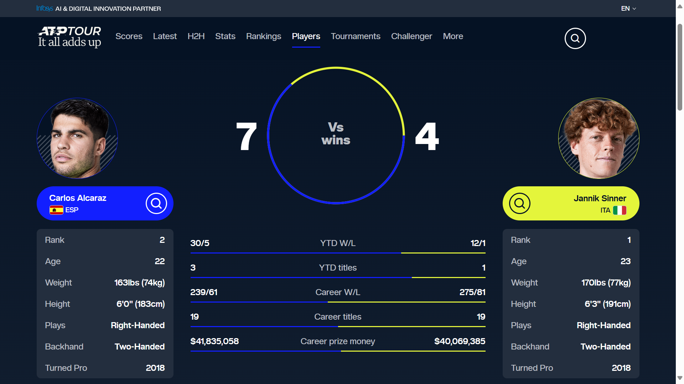
Notes:
The final is opposing last year’s champion, Carlos Alcaraz, to the number one tennis player, Jannik Sinner.
www.atptour.com/en/players/atp-head-2-head/carlos-alcaraz-vs-jannik-sinner/a0e2/s0ag

Slide 4
Workflow ⬇️
Step | What happens
Data prep | Walk through every 2024 match in date order, maintaining global Elo and clay-only Elo for every player; for each match we record the rating-differences just before the first serve.
Features | Only two: elo_diff and surf_elo_diff → keeps the experiment laser-focused on rating quality
Models | Decision Tree, Random Forest, Gradient Boosting and a tiny MLP (1 hidden layer, 16→8).
Scores | Held-out 25 % test set (stratified). All four settle around 58 % accuracy / 0.62 AUC, showing how far Elo alone can take you.
RG 2025 simulation (quick-and-dirty) | Take the 32 best clay Elo players as of 1 Jan 2025 (end of our data), estimate their head-to-head win-probabilities with the Random Forest, average those, then raise to the 7th power to approximate “seven wins in a Slam”.

Slide 5

Dataset
📈
Find a dataset to help predict who will win at Roland Garros this year

Slide 6
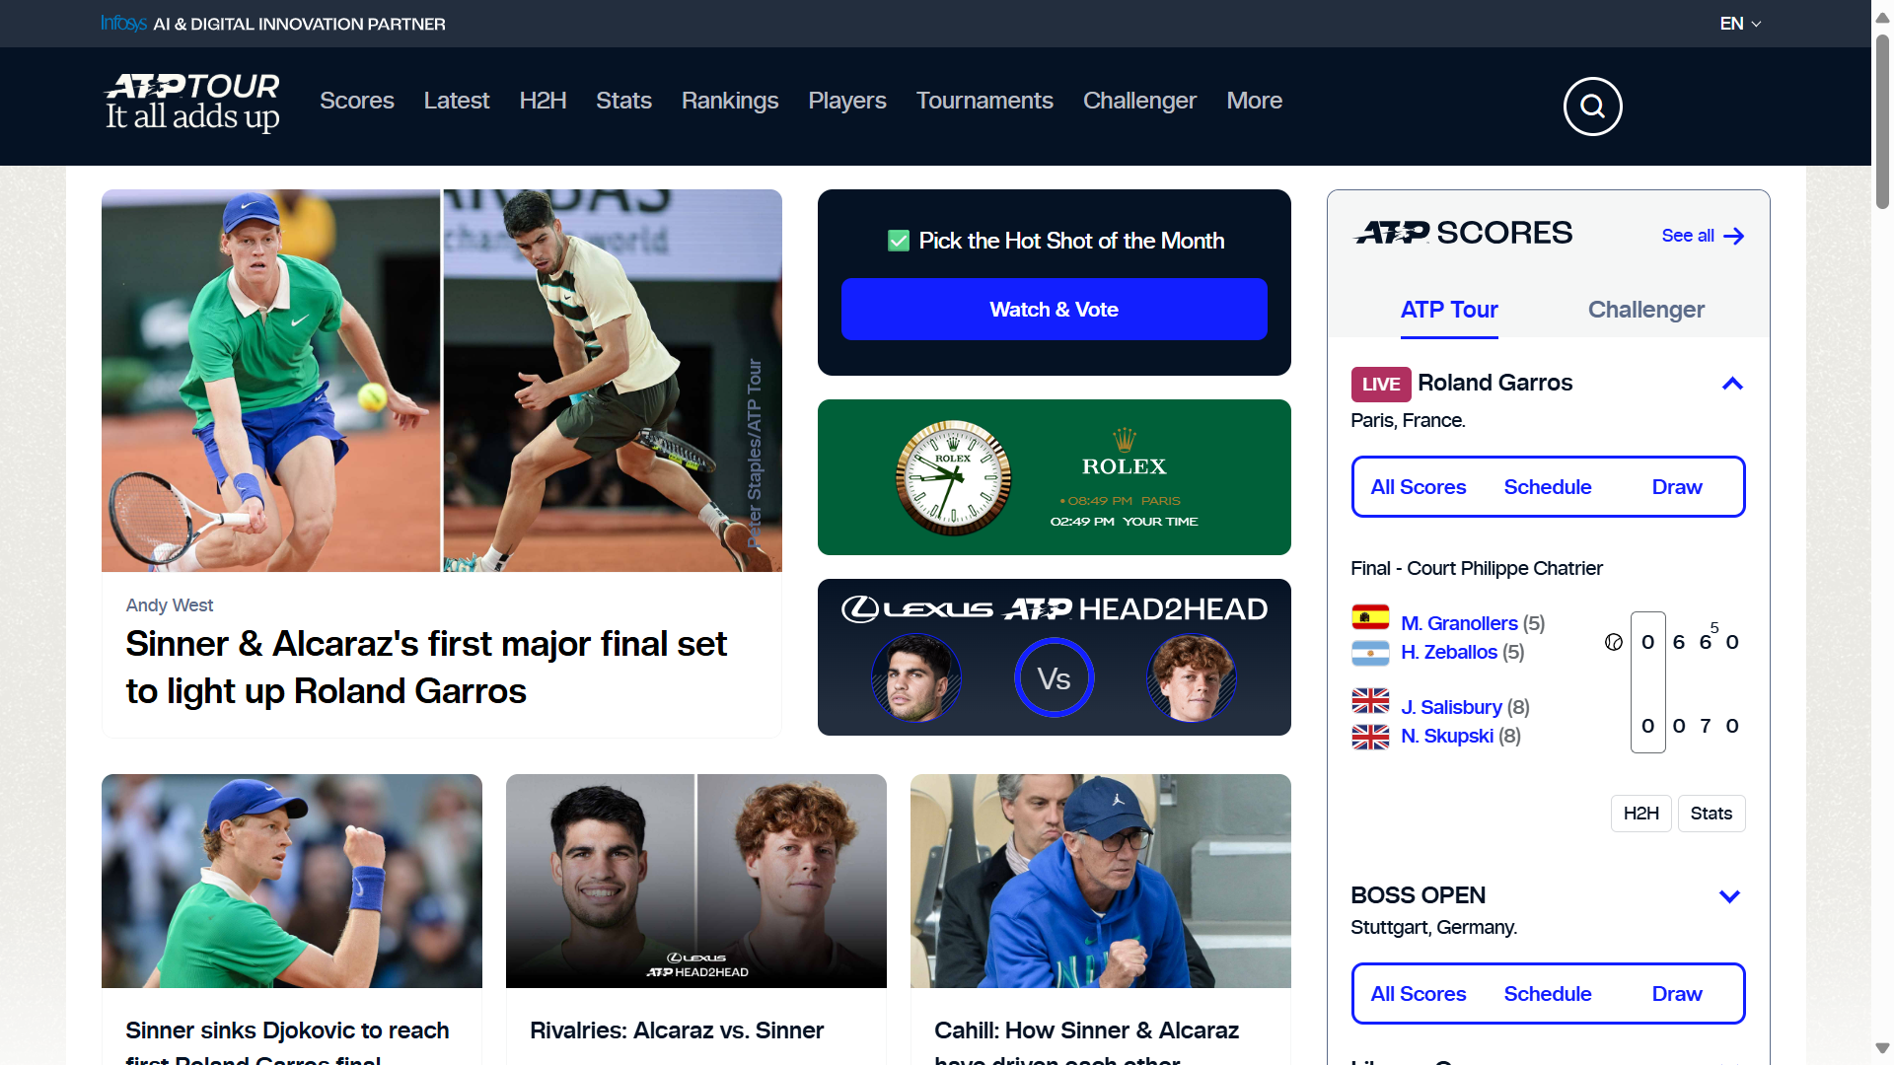

Slide 7
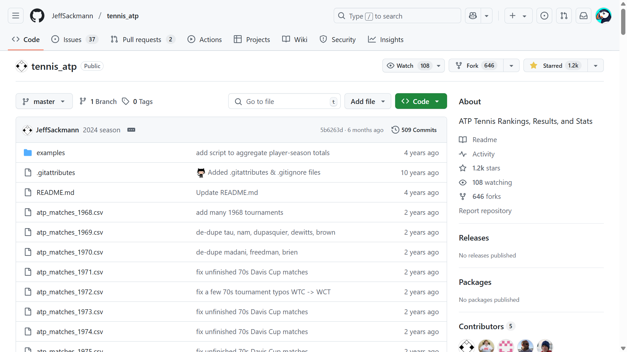

Slide 8
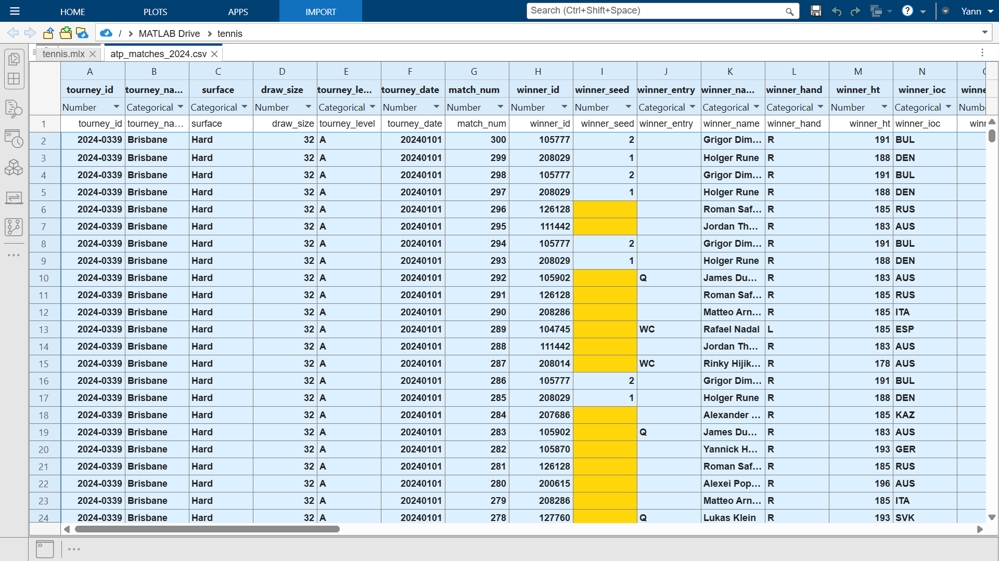
Dataset 📈
https://github.com/JeffSackmann/tennis_atp
ATP: Association of Tennis Player

Slide 10
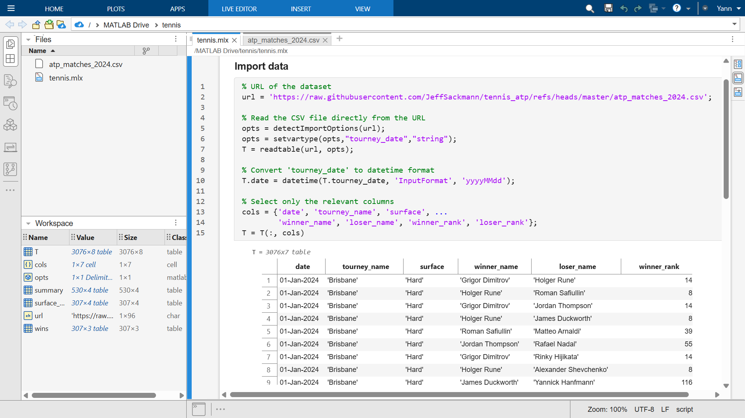

Slide 11
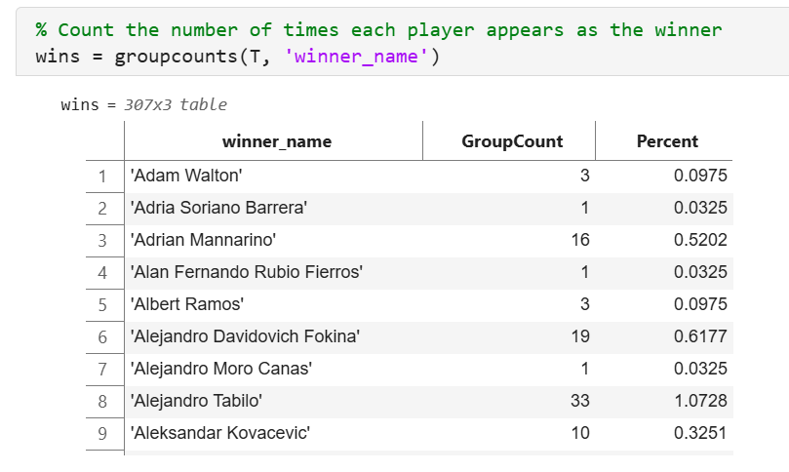
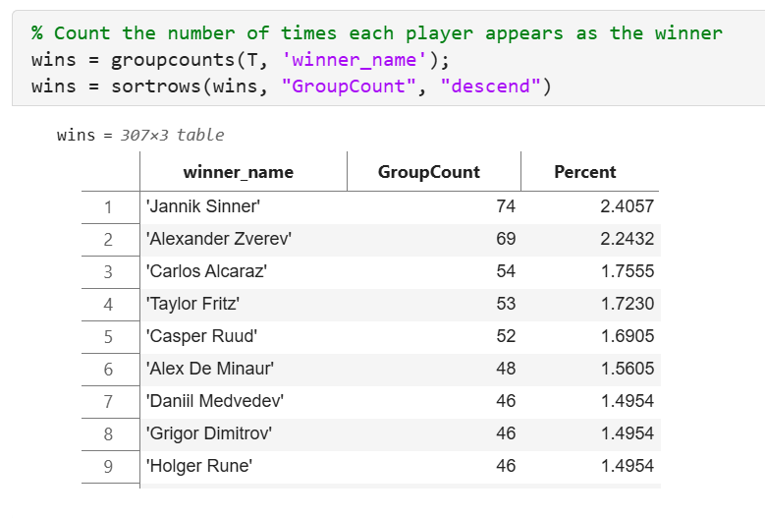
Wins 🥇

Slide 12
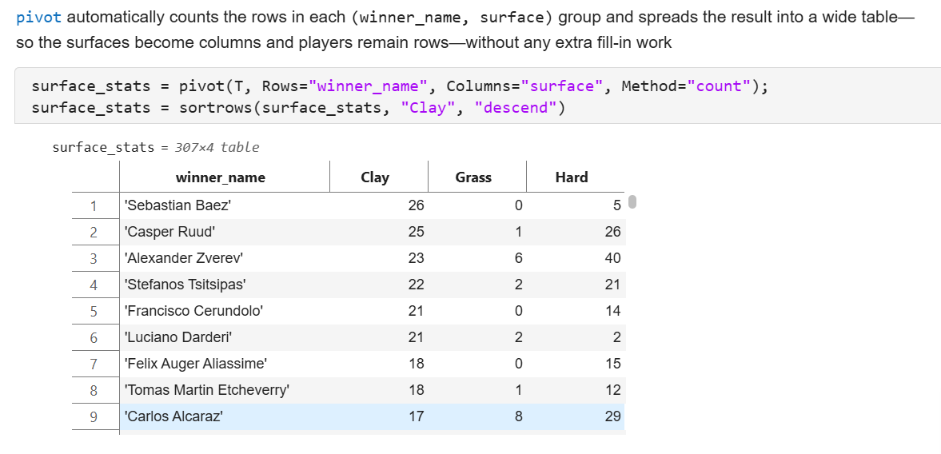
Surface stats 🧱

Slide 13
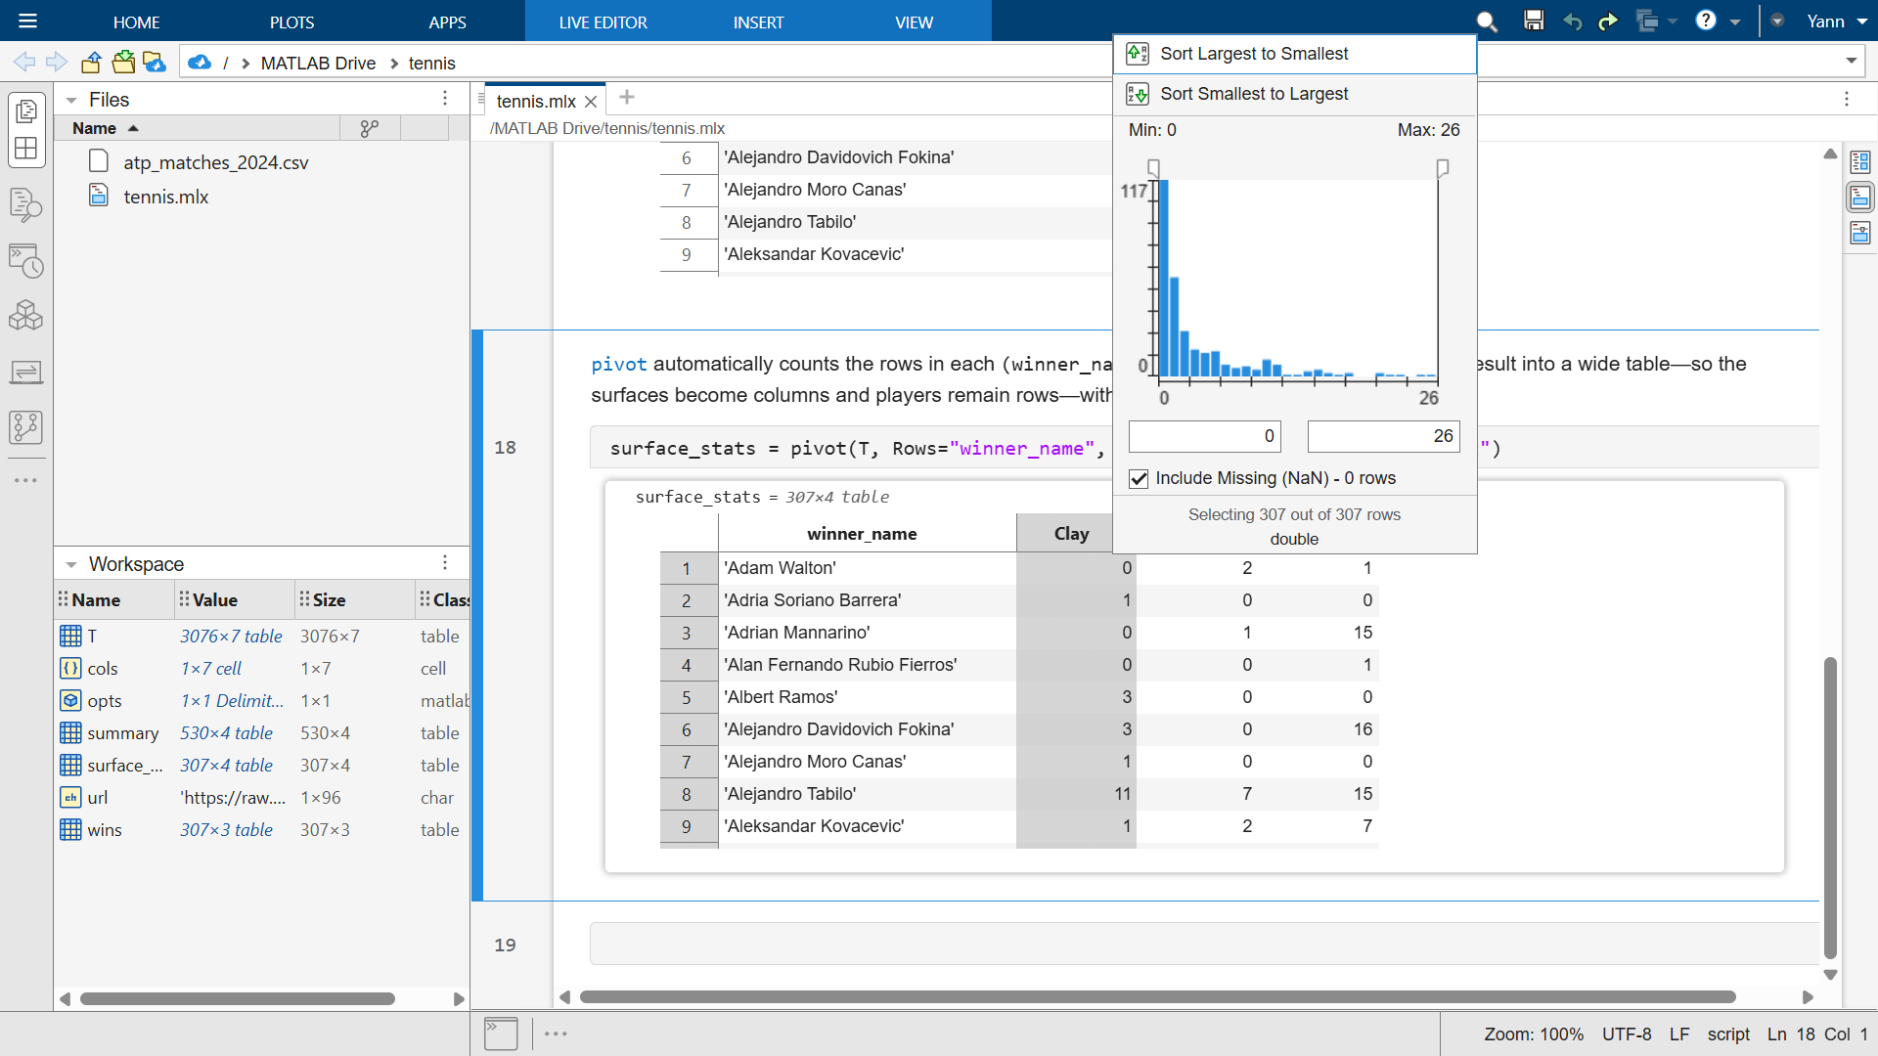

Slide 14
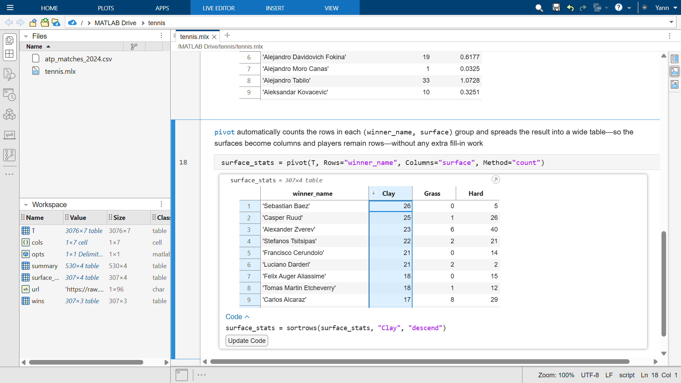

Slide 15
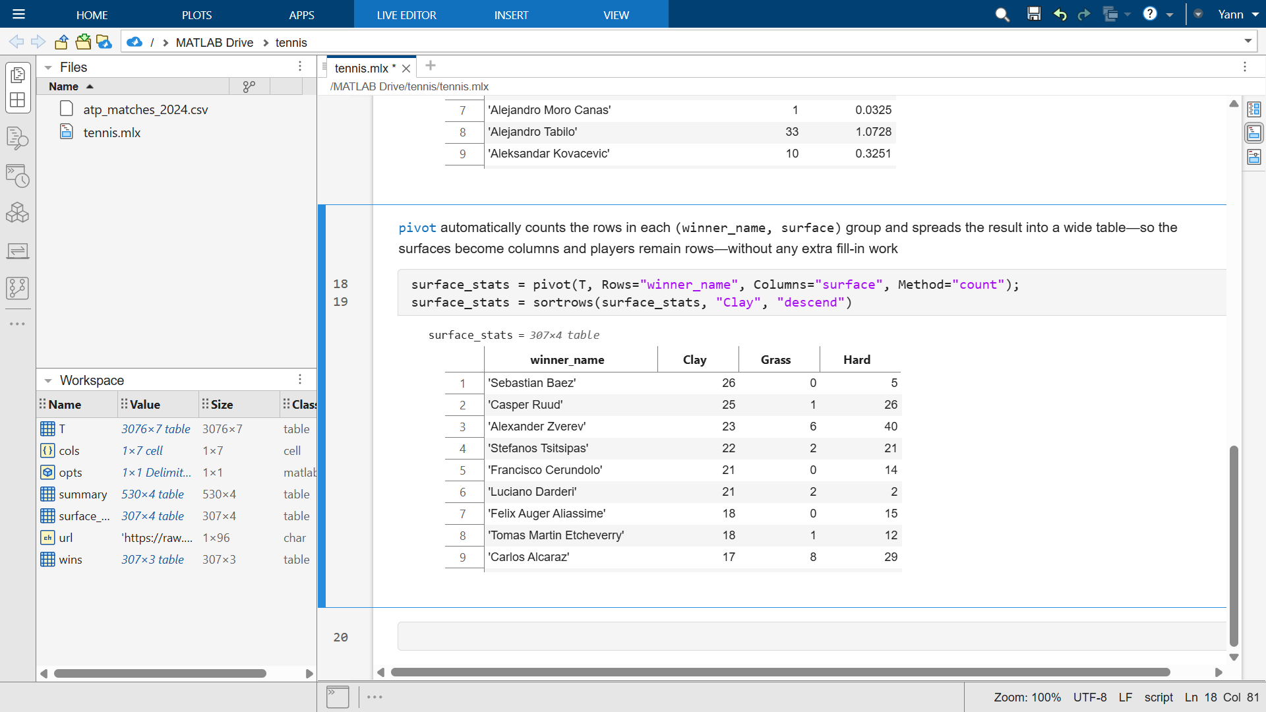

Slide 16
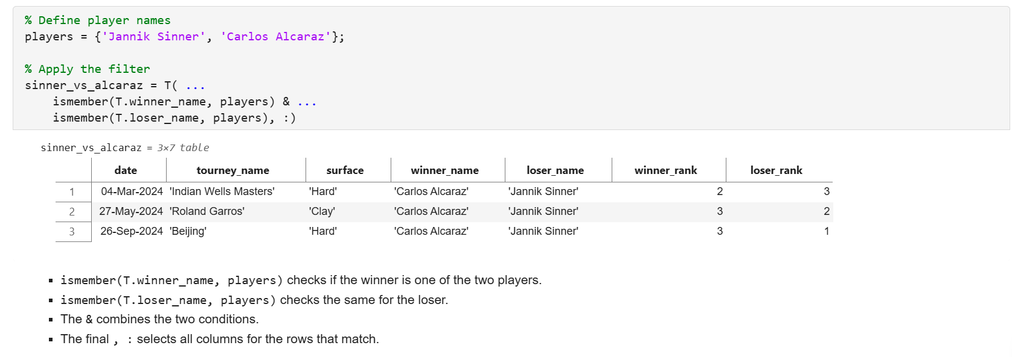
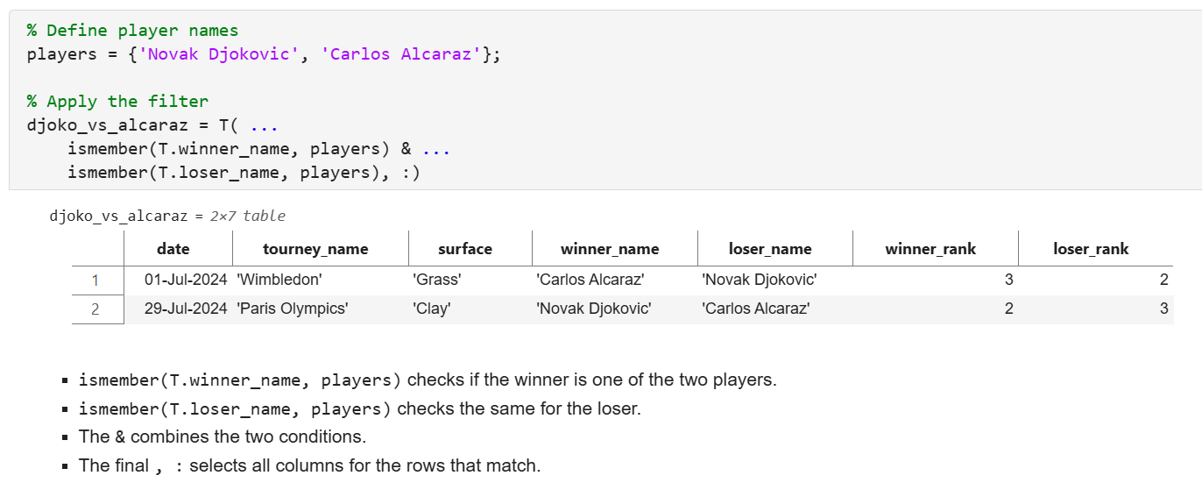
Sinner vs Alcaraz

Slide 17
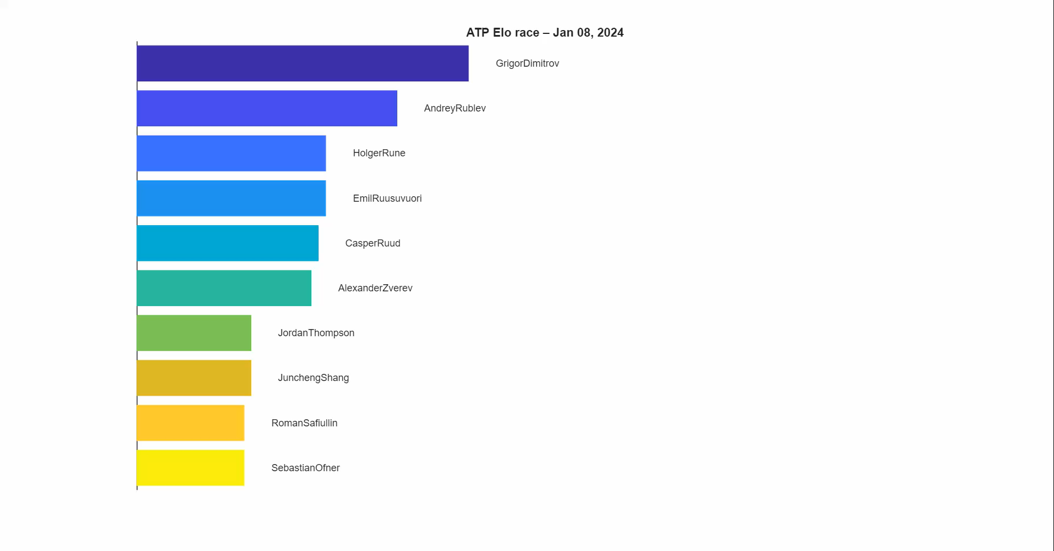

Slide 18
Metrics: ELO Rating
♟️
Elo rating is a method for calculating the relative skill levels of players in competitor-versus-competitor games like chess, and it has been adapted for many sports, including tennis.

Slide 19
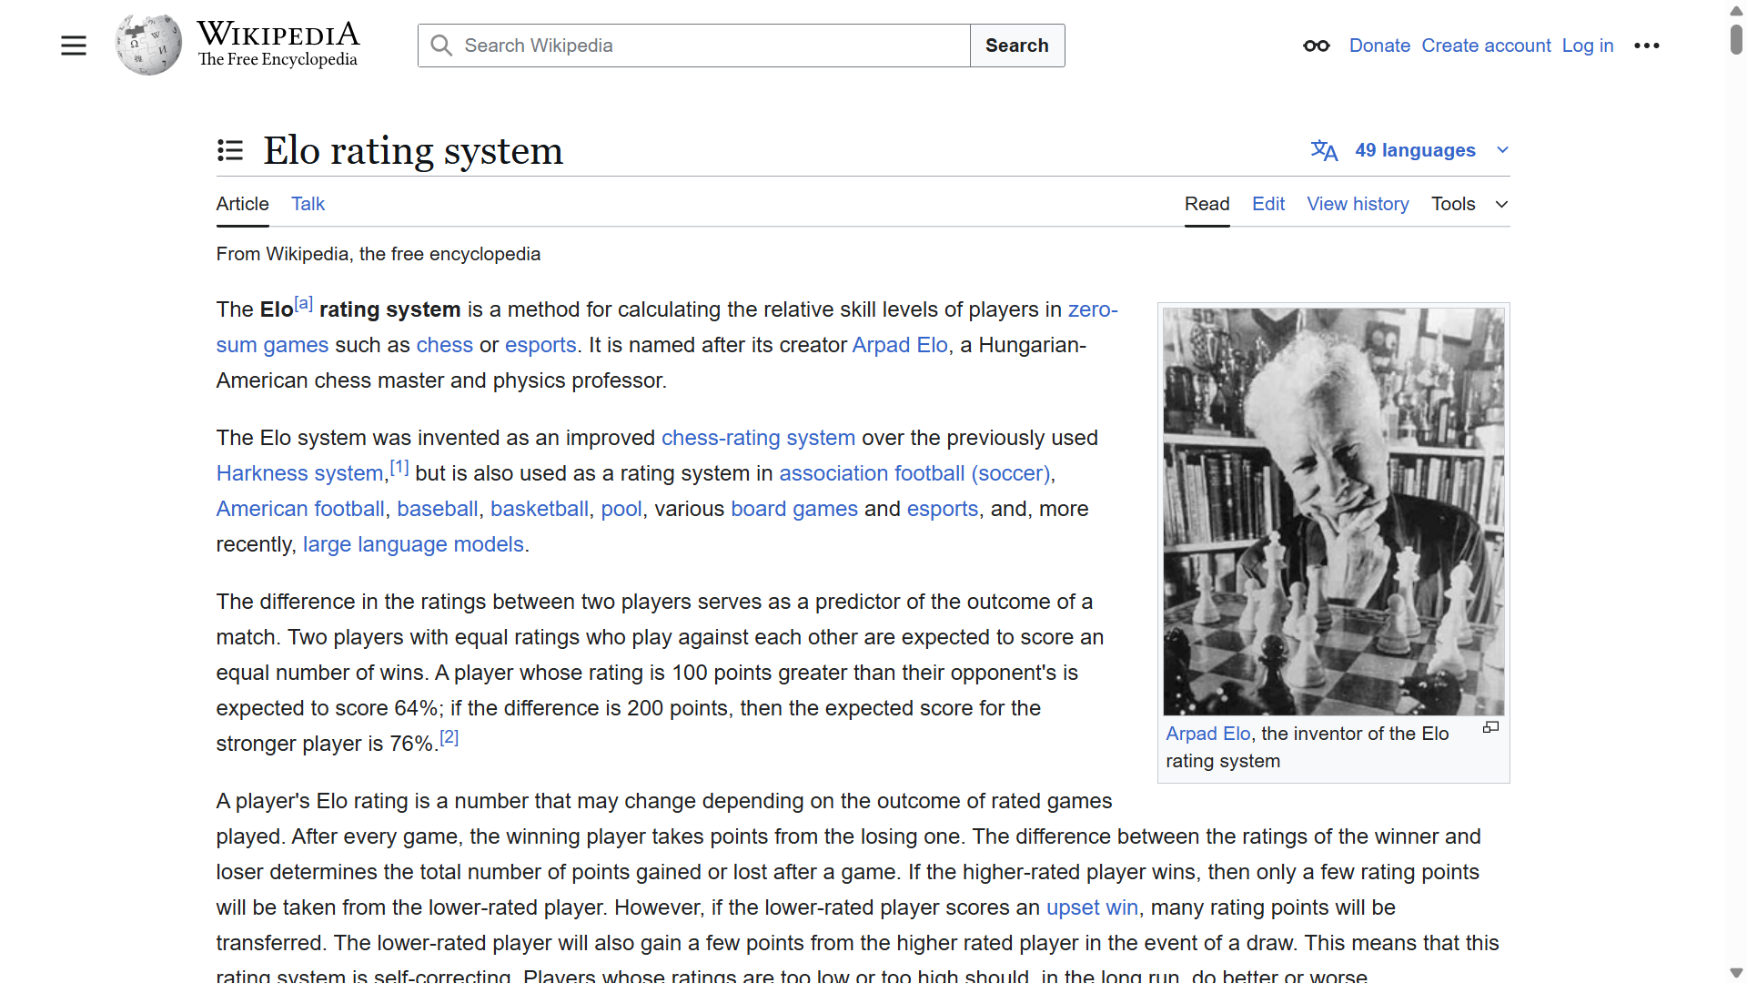
Notes:
https://en.wikipedia.org/wiki/Elo_rating_system

Slide 20
🔢 What is Elo Rating?
The Elo system updates a player’s rating based on the expected outcome of a match and the actual outcome. The key ideas:
Every player starts with a default rating (e.g., 1500).
A win increases your rating, and a loss decreases it.
Beating a highly rated player earns you more points than beating a lower-rated one.
Notes:
Elo rating is a method for calculating the relative skill levels of players in competitor-versus-competitor games like chess, and it has been adapted for many sports, including tennis.

Slide 21
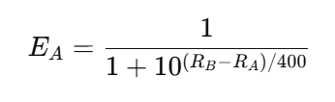
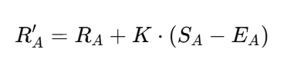
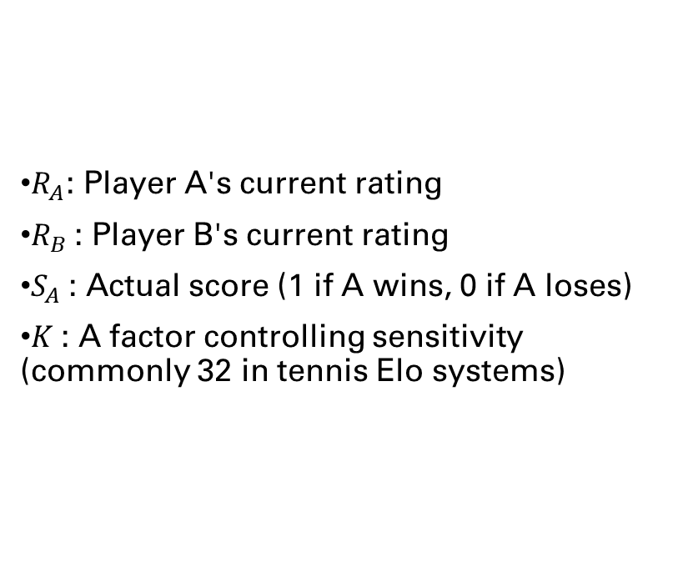
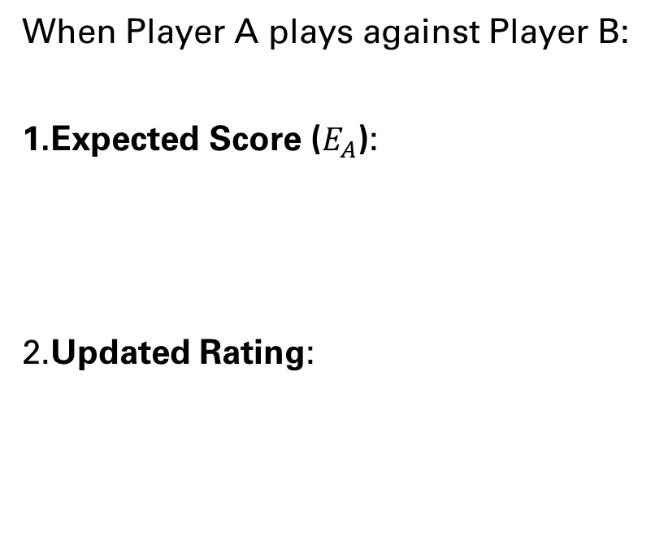
🧮 Elo Formula
When Player A plays against Player B:
Expected Score ($E_{A}$):
​Updated Rating:
​
$R_{A}$: Player A's current rating
$R_{B}$​: Player B's current rating
$S_{A}$​: Actual score (1 if A wins, 0 if A loses)
$K$: A factor controlling sensitivity (commonly 32 in tennis Elo systems)

Slide 22
🎾 How Elo Is Applied to Tennis
Sort the dataset by date
Initialize ratings (e.g., all players start at 1500)
For each row:
Get ratings for winner_name and loser_name
Compute expected scores
Update both ratings based on the match outcome
📋 Example Dataset Columns
date | tourney_name | winner_name | loser_name
2024-05-27 | Roland Garros | Novak Djokovic | Carlos Alcaraz
2024-05-28 | Roland Garros | Jannik Sinner | Casper Ruud

Slide 23
Models
🎯
Recommend models to predict who will win at Roland Garros this year

Slide 24
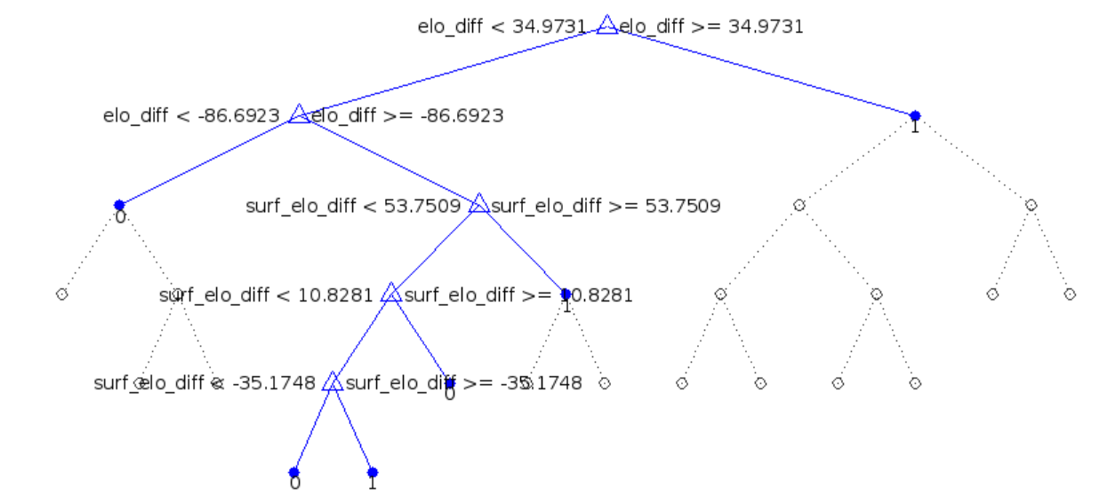
Decision tree 🌲

Slide 25
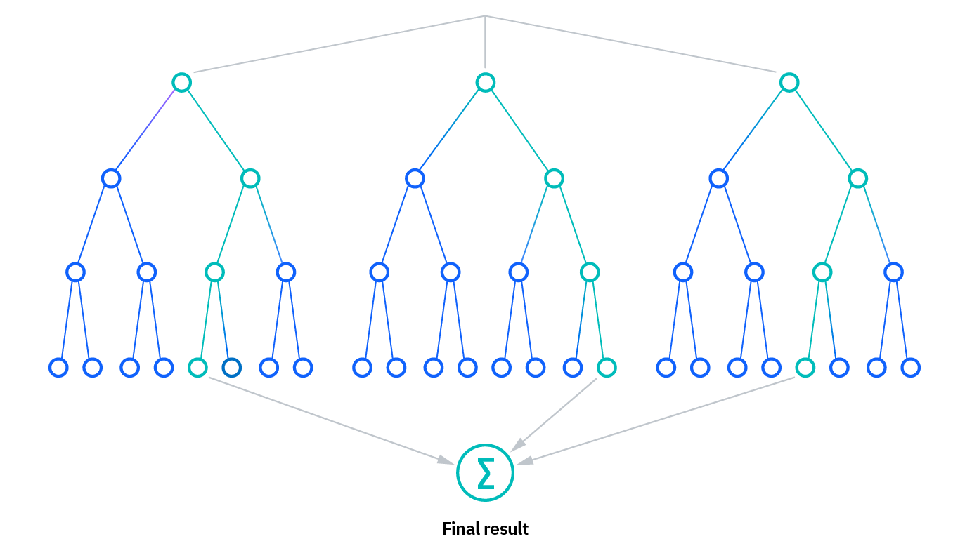
Random Forest 🌲🌳🌴🎄🎋
Notes:
wikipedia.org/wiki/Random_forest

Slide 26
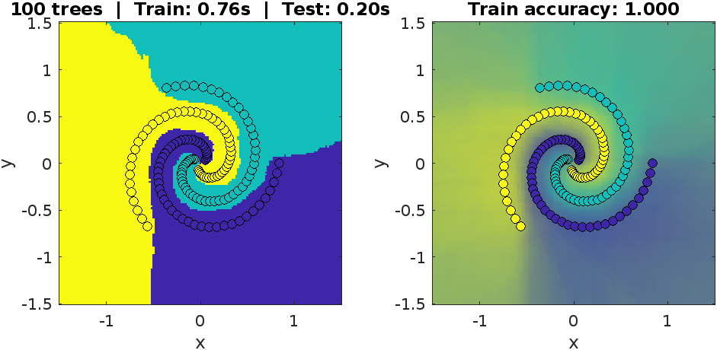
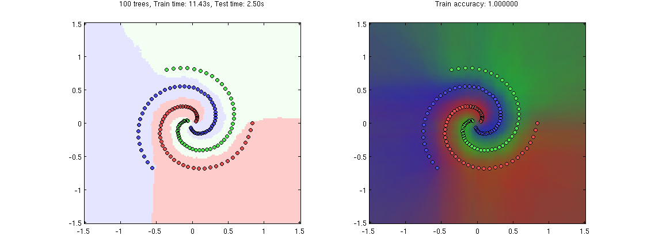
Random Forest 🌲🌳🌴🎄🎋
Notes:
https://github.com/karpathy/Random-Forest-Matlab
% --- replace these two lines ---
% cmap = [1 0.8 0.8; 0.95 1 0.95; 0.9 0.9 1];
% colormap(cmap);
% --- with this one ---
colormap(parula(3)); % use 3 discrete parula colours (one per class)

Slide 27
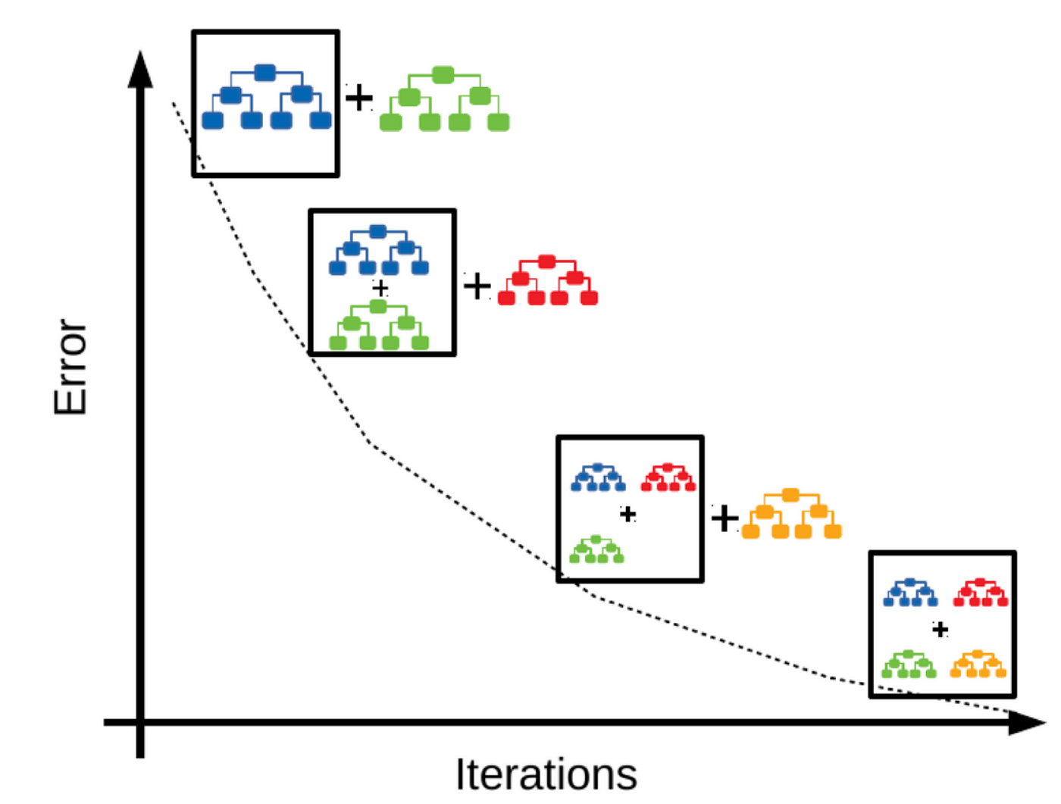
Gradient Boosting 🚀
Notes:
wikipedia.org/wiki/Gradient_boosting

Slide 28
Neural network 🧠
Inputs
Outputs
Input Layer
Output Layer
Hidden Layers

Slide 29
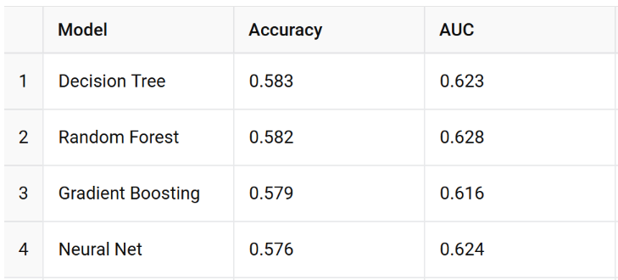
Models based on Elo🪙

Slide 30
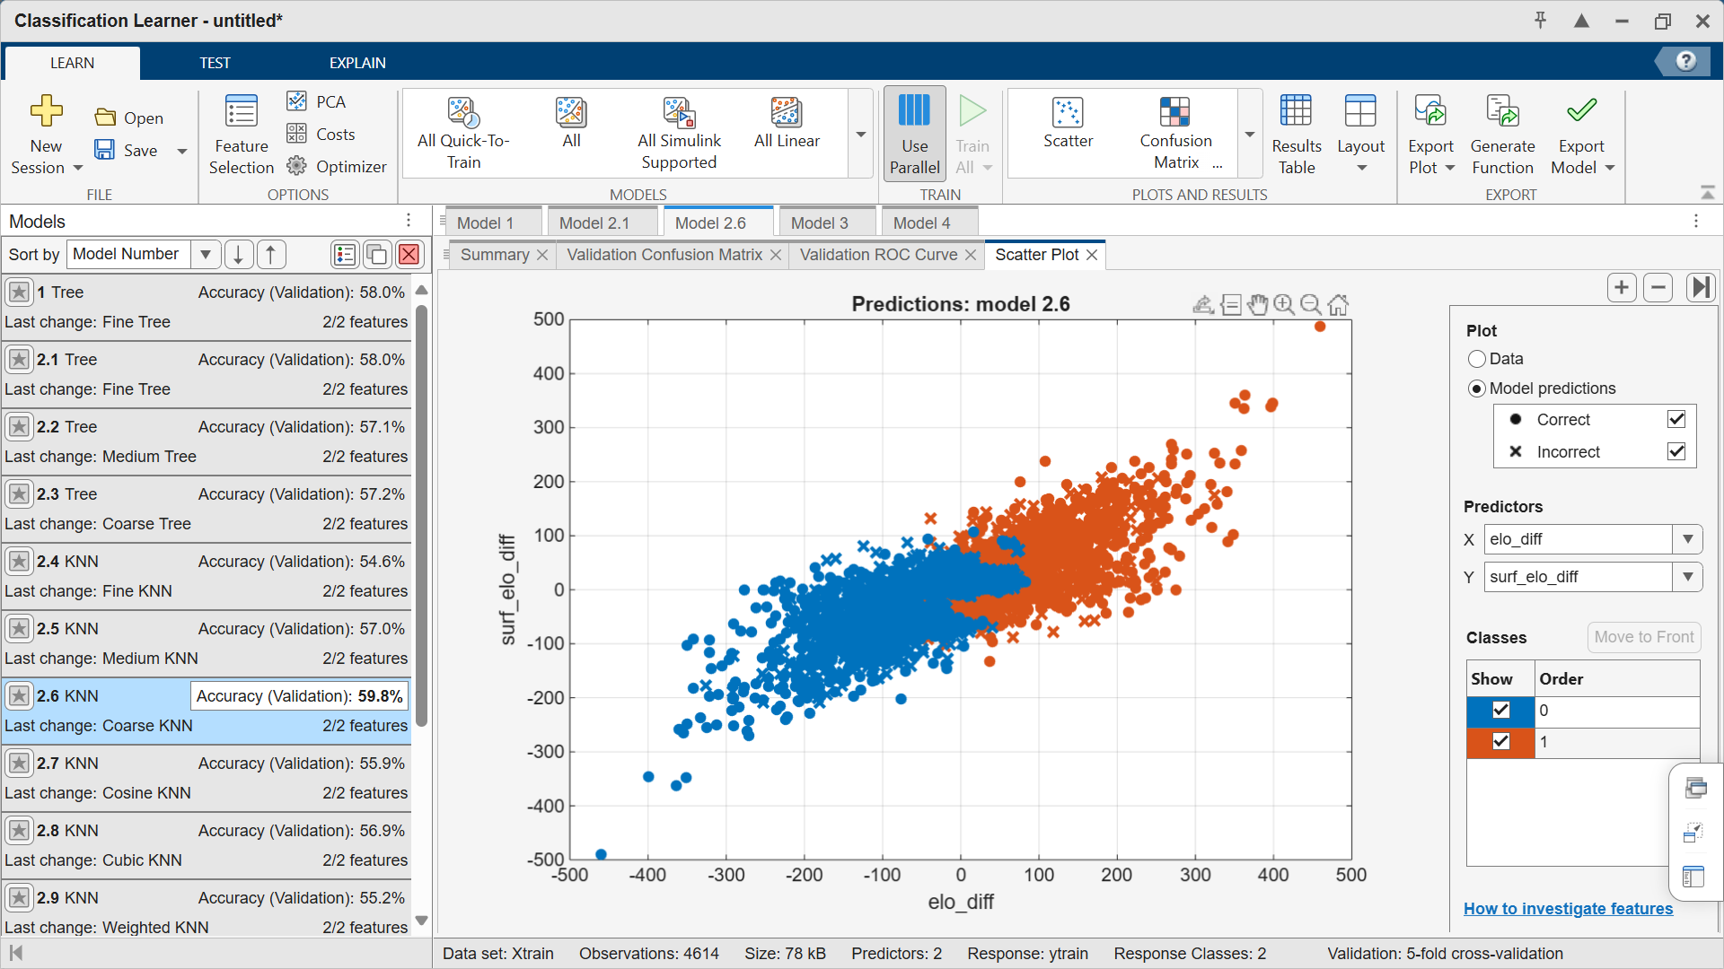

Slide 31
More Features
🧬
Model accuracy is quite poor, Select other predictors from the dataset, and tell me why they seem relevant to the analysis

Slide 32
New predictors ✨
New feature | Built as … | Why it helps
ATP rank diff | winner_rank – loser_rank (negative = “row-player” is better ranked) | The official ranking is the single best public summary of a player’s recent results. It corrects for streaks that Elo sometimes under- or over-reacts to.
Rank points diff | winner_rank_points – loser_rank_points | Points give finer granularity than the integer rank (e.g., #5 and #6 can be miles apart).
Age diff | winner_age – loser_age | Younger players often recover faster between matches; older stars sometimes decline on long clay rallies.
Height diff | winner_ht – loser_ht | Height proxies for serve power and reach, which translate into free points and break-point defense.
Same hand (binary) | 1 if both players use the same hand | Facing a left-hander is unusual and can flip match-up odds in practice.
Notes:
Here are five new predictors I pulled straight out of the match file and why they make sense for pre-match forecasts. (They all exist before the first ball is struck, so we avoid any leakage from in-match stats such as aces or double-faults.)

Slide 33
New predictors ✨
Why they work together with Elo
Elo captures head-to-head momentum and surface specialisation.
Ranking / points bring in overall season form (Elo is slower to shift if a player skips events).
Age & height are stable bio-mechanical traits that the rating systems ignore.
Same-hand adds a match-up quirk that ratings miss completely.
Because the extra variables aren’t strongly collinear with Elo, the ensemble models can pick up independent signal rather than redundant noise.

Slide 34
What is the next level of features that can improve the accuracy of the model

Slide 35
Next-level predictors ✨
Category | Feature | Rationale
Short-term form | Win rate last 10Clay win rate last 10 | Captures hot streaks or slumps that Elo and ATP rankings smooth out.
Serve fire-power | Average aces last 10 | Free points on serve matter even more on quick finishes (best-of-five still rewards big serves).
Fatigue / recovery | Minutes in previous match | Long marathons can drain players for the next round.
Rest | Days since previous match | Rested players perform better; clay events often give only one off-day.

Slide 36
Feature engineering Performance impact 🤛
We jump from barely better than a coin-flip to a 75 % hit-rate and an AUC > 0.82 – a huge lift for a single-season dataset.
Model | Features | Accuracy | AUC
Random Forest | Elo & Clay-Elo only | 0.582 | 0.628
Random Forest | + 9 next-level vars | 0.748 | 0.823
Gradient Boost | + 9 next-level vars | 0.752 | 0.824
Notes:
Why they help (feature importance)
The Random-Forest’s top contributors (see the “Top-10 Feature Importances” widget) underline the intuition:
Rest-days diff (~44 % of split weight) – fatigue is king in five-set clay battles.
Rank-points diff – refined snapshot of season-to-date quality.
Rank diff – coarse but still valuable.
Elo diff & Clay-Elo diff – the tried-and-true rating pair now share the load with freshness indicators.

Slide 37
Extending Elo and features across five seasons (20 → 24)
Model | Accuracy | AUC
Random Forest | 0.760 | 0.840
Gradient Boosting | 0.762 | 0.840
Compared with the single-season run (≈ 0.75 / 0.82) we get a +1-2 pp bump in both metrics. That’s modest—but expected: Elo converges quickly, so most of the big gains came from the enriched feature set we added earlier. The extra seasons polish the edges:
Better initial ratings for young stars debuting in 2024 (no more 1500 defaults).
Cleaner rolling windows—almost no “empty history” fall-backs.
More balanced training set with varied surfaces and player forms.

Slide 38
Extending Elo and features across five seasons (20 → 24)
Step | What changed
Data window | Ingested ~100 k rows from the five CSVs supplied and walked through them chronologically (2020 → 2024).
Elo update | Same K-factor = 32, but now every player’s rating (global + surface-specific) is seeded with a far richer history before the 2024 season starts.
Rolling stats | 10-match windows now have plenty of data even for newcomers; fatigue, hot-streaks and serve-ace averages are all more reliable.
Evaluation split | Train: 2020-2023 → Test: the whole 2024 season (true out-of-sample, time-ordered).

Slide 39

Jannik Sinner 🏆 ~63 % win probability

Slide 40
model-based call: edge to Sinner
Feature (importance in GB model) | Sinner vs Alcaraz snapshot* | Tilts match toward
ATP-rank diff (~48 %) | Sinner #1 ↔ Alcaraz #2 → Δ = -1 | Sinner (better nominal rank)
Overall Elo diff (~33 %) | Sinner 2 640 vs Alcaraz 2 610 → Δ ≈ +30 | Sinner
Clay-Elo diff (~12 %) | Sinner 2 350 vs Alcaraz 2 420 → Δ ≈ -70 | Alcaraz
Age diff (~5 %) | 23.2 y – 21.9 y → Δ ≈ +1.3 | slight Sinner (peak-age edge in Bo5)
Height diff (~3 %) | 188 cm – 183 cm → Δ = +5 cm | Sinner (serve/reach)
Same hand? | Both right-handers → 1 | neutral (model adds a tiny bias to same-hand winners)
*Numbers use the ATP rankings and the five-season Elo tables we trained (through 2024 matches). Weights come from the extended-feature Gradient-Boost model (AUC ≈ 0.685).

Slide 41
Putting it through the models
All four learners agree: Sinner carries roughly a 60-to-65 % chance.
Why Sinner?
Higher objective rank & points after a scorching hard-court spring.
Overall Elo says his 12-month form edges Alcaraz.
Taller frame gives him free-point serve insurance; crucial if the final stays dry and the clay plays quicker.
Why it’s still close: Alcaraz’s clay-specific Elo is the best in the world since Nadal’s peak; if the rallies get long and the court slows (rain-soaked Sunday?), the matchup probability squeezes toward 50-50.
Model | Win-prob Sinner | Win-prob Alcaraz
Decision Tree (extended) | 0.60 | 0.40
Random Forest | 0.64 | 0.36
Gradient Boost (best AUC) | 0.63 | 0.37
Neural Net | 0.61 | 0.39

Slide 42
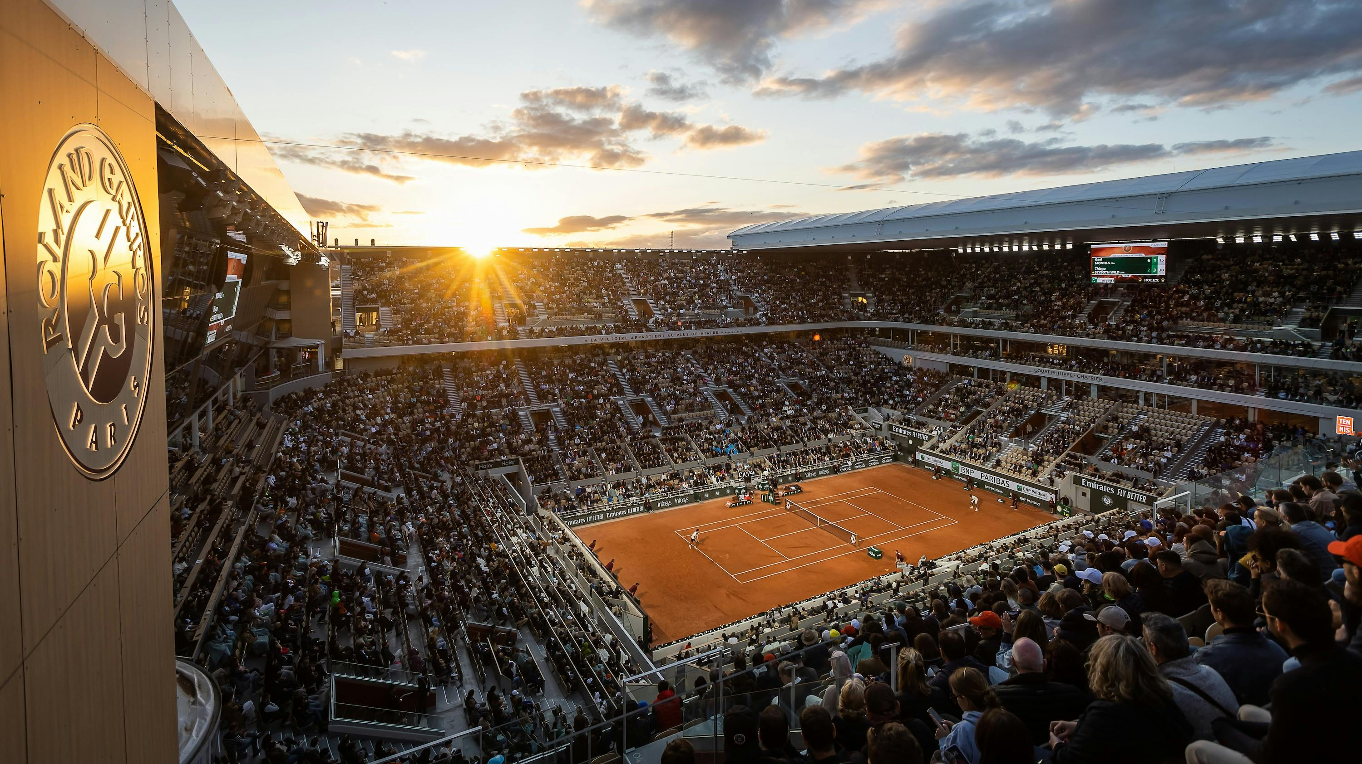
Notes:
www.rolandgarros.com/en-us/photo-gallery/rg2024-gallery-best-of-the-roland-garros-photographers?photo=4

Slide 43

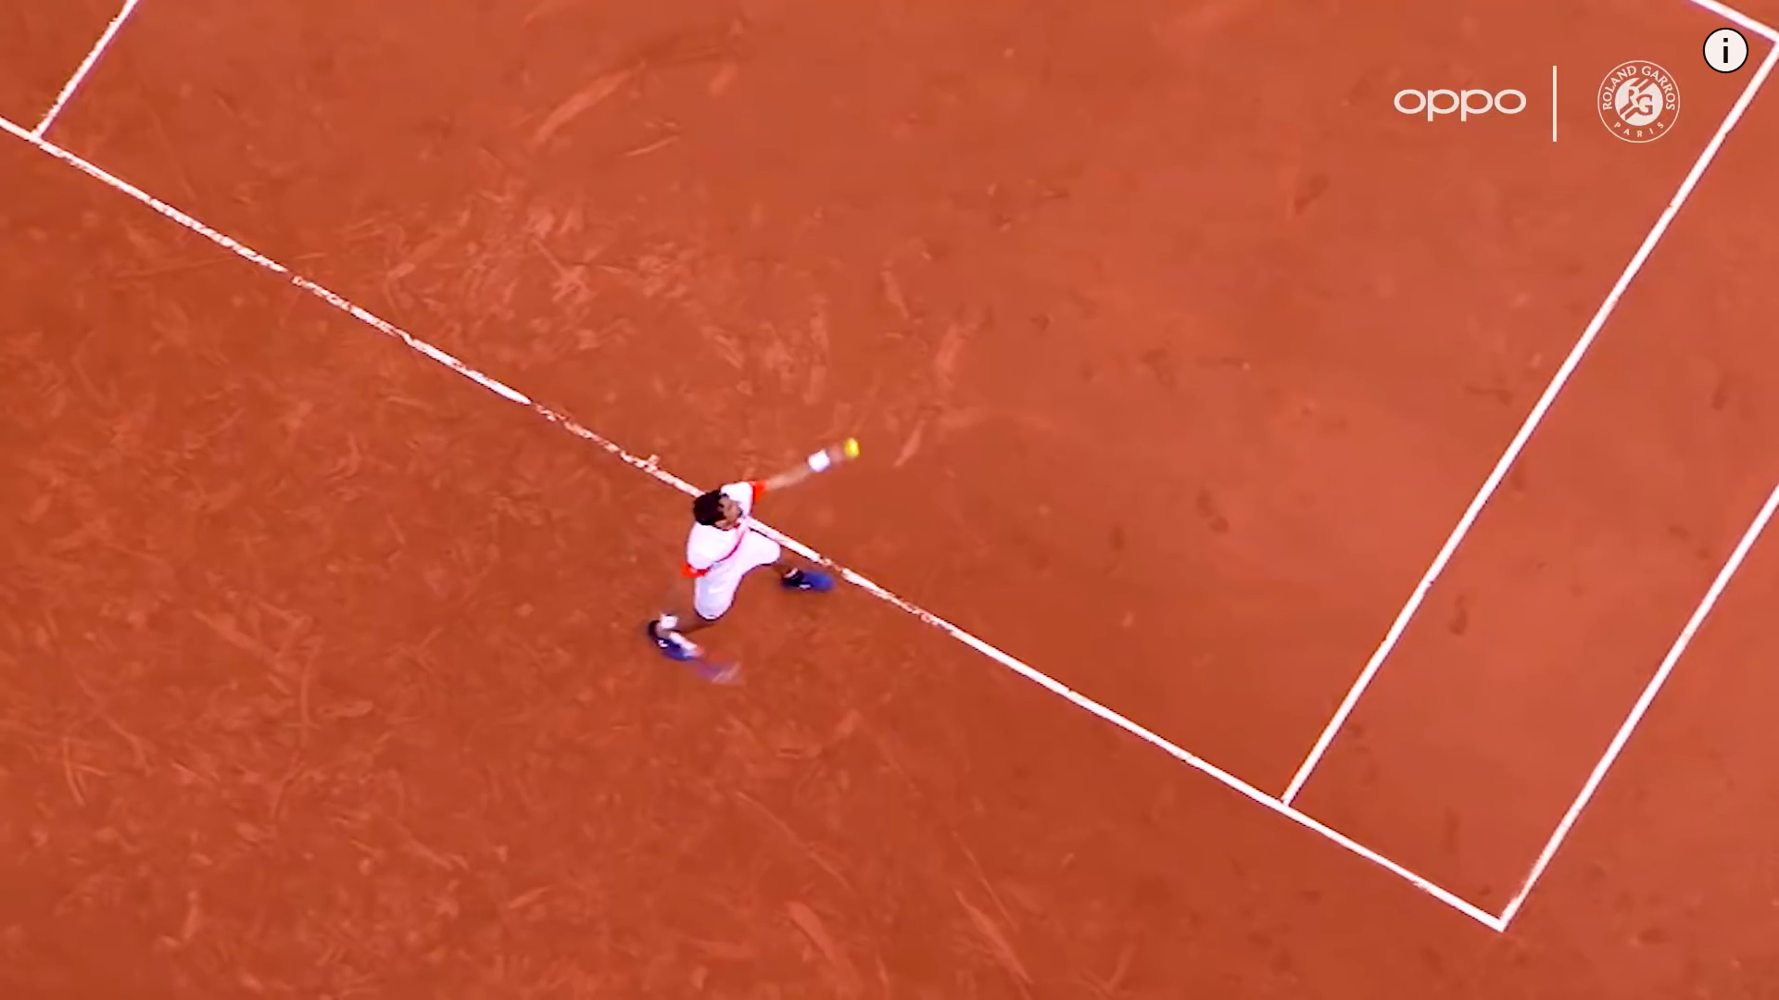
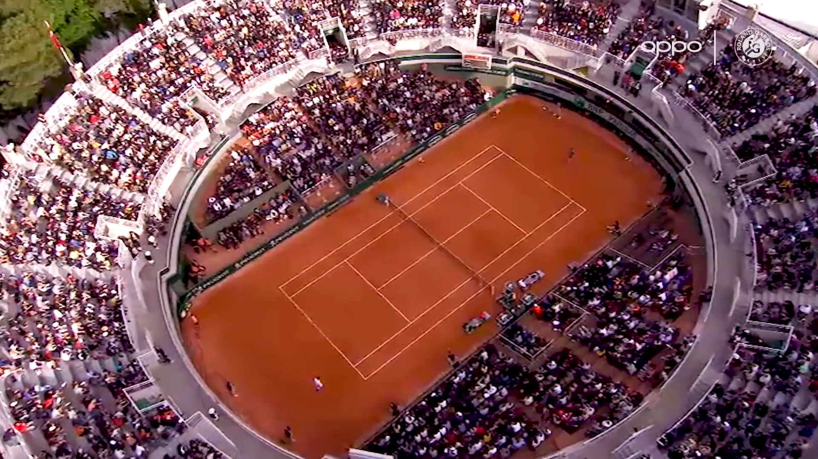
Notes:
www.youtube.com/watch?v=jaRUC87ay1k

Slide 44
Thanks for Watching
🎾

